Slide 1
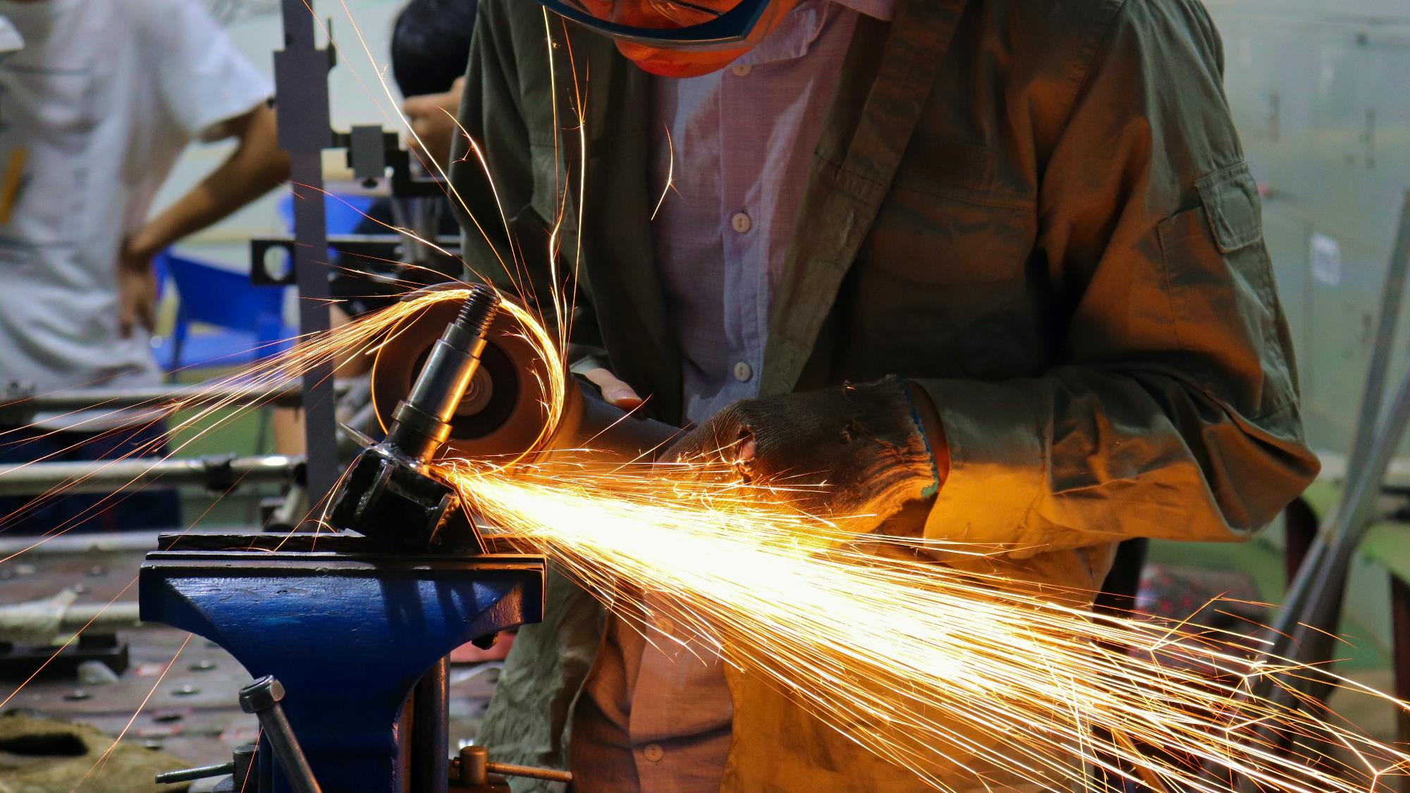
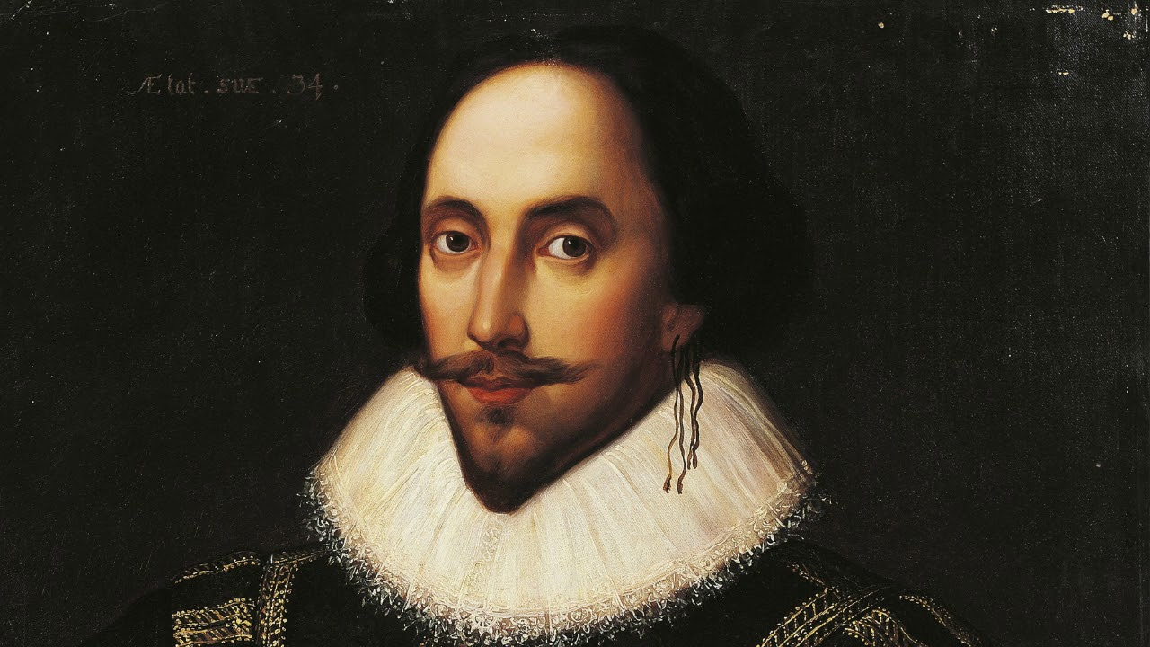
William Shakespeare
was an English playwright, poet and actor
Vaganova O.
Group №3834101/30001

Slide 2
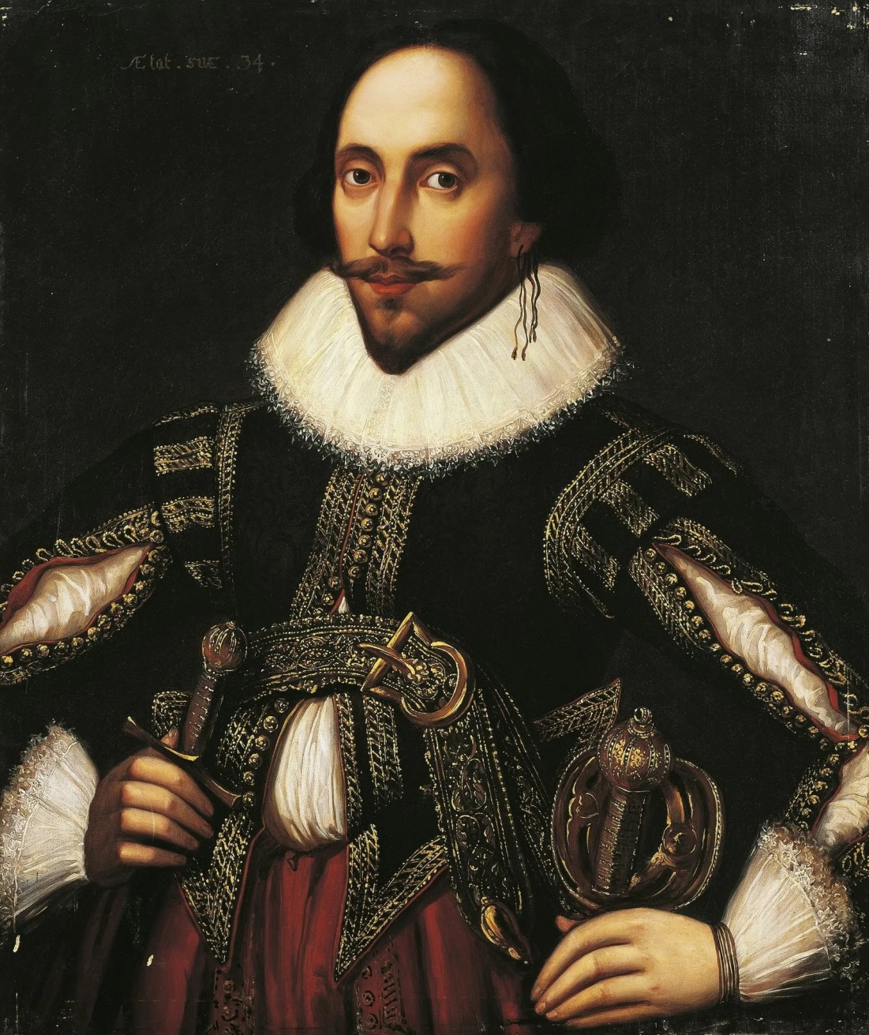
William Shakespeare
William Shakespeare was born on 23rd April 1564 in Stratford upon Avon in England.
Tradition holds that Shakespeare died on his 52nd birthday, April 23, 1616. The exact cause of Shakespeare’s death is unknown, though many people believe he died following a brief illness.

Slide 3
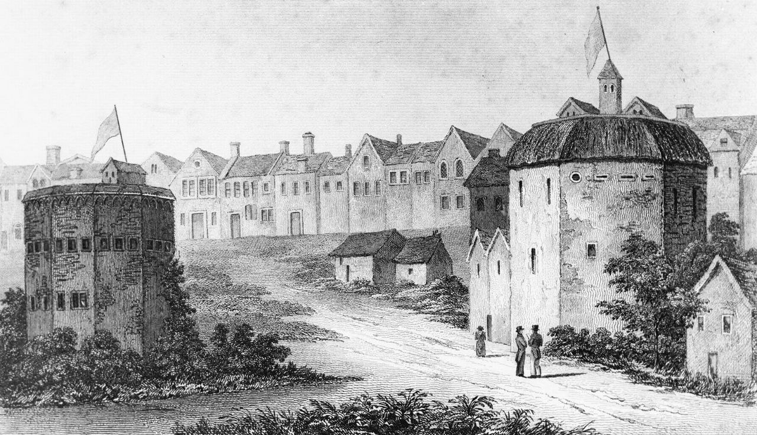
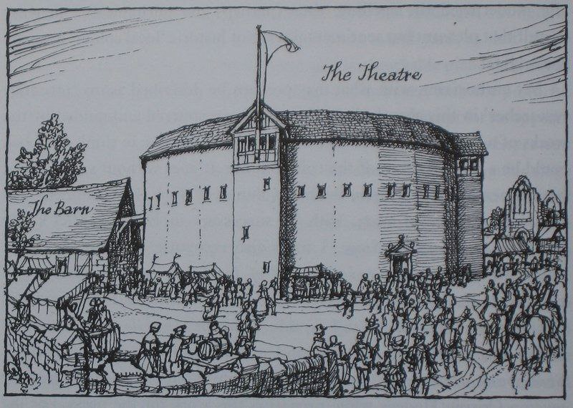
William Shakespeare
In 1594, Shakespeare joined Lord Chamberlain’s Men, the London acting company that he worked with for the duration of his career.
By 1599, Shakespeare and several fellow actors built their own theater, which they called
the Globe Theater.

Slide 4

William Shakespeare
Known throughout the world, Shakespeare’s works—at least
37 plays, 154 sonnets, and 2 narrative poems.
Shakespeare produced most of his known works between 1589 and 1613

Slide 5
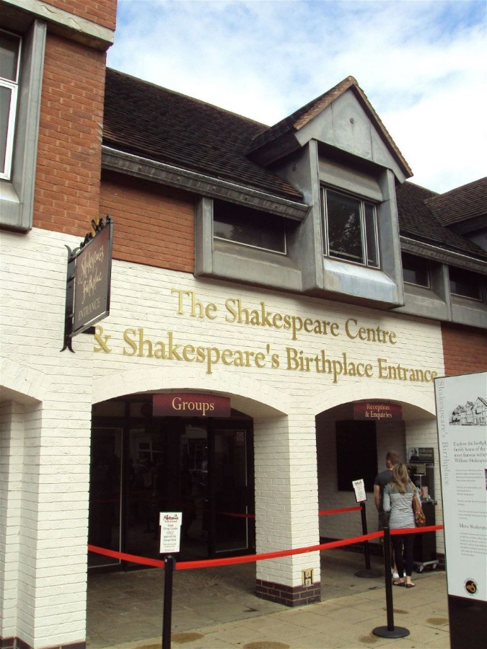
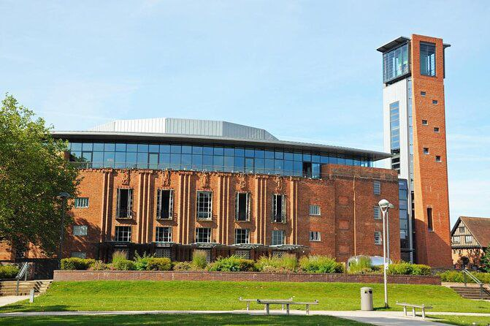
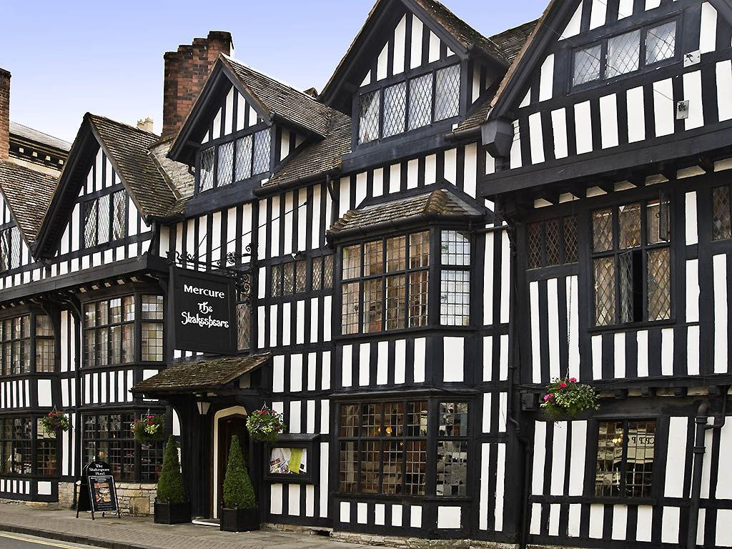
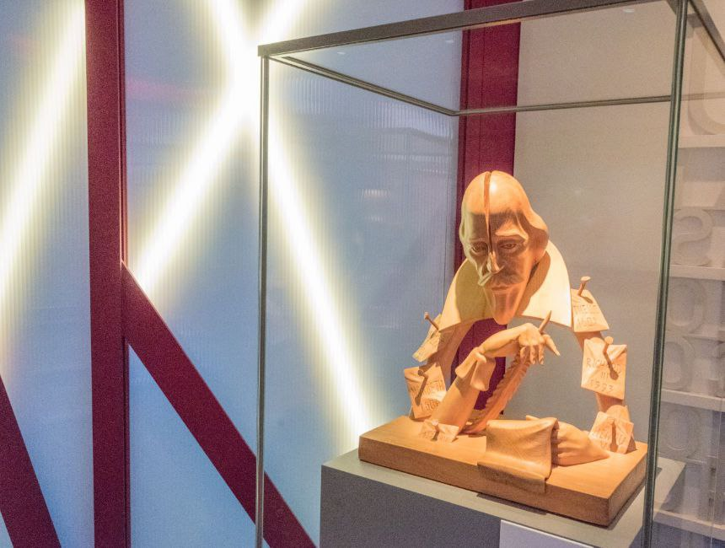
Stratford is a town dedicated to Shakespeare’s life and work
Visitors come there from all over the world to learn more about Shakespeare’s life.

Slide 6
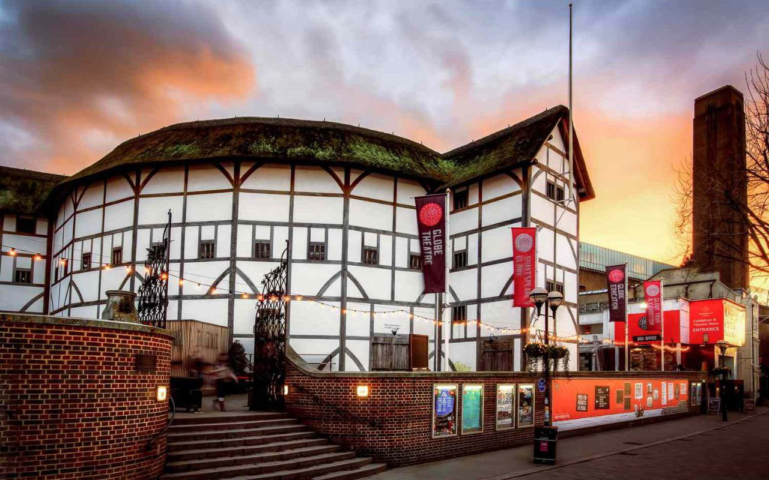
The Globe Theatre
The Globe used to be one of the biggest theatres in London and since its restoration in 2000, audiences there have been able to experience what going to the theatre used to be like 400 years ago.

Slide 7
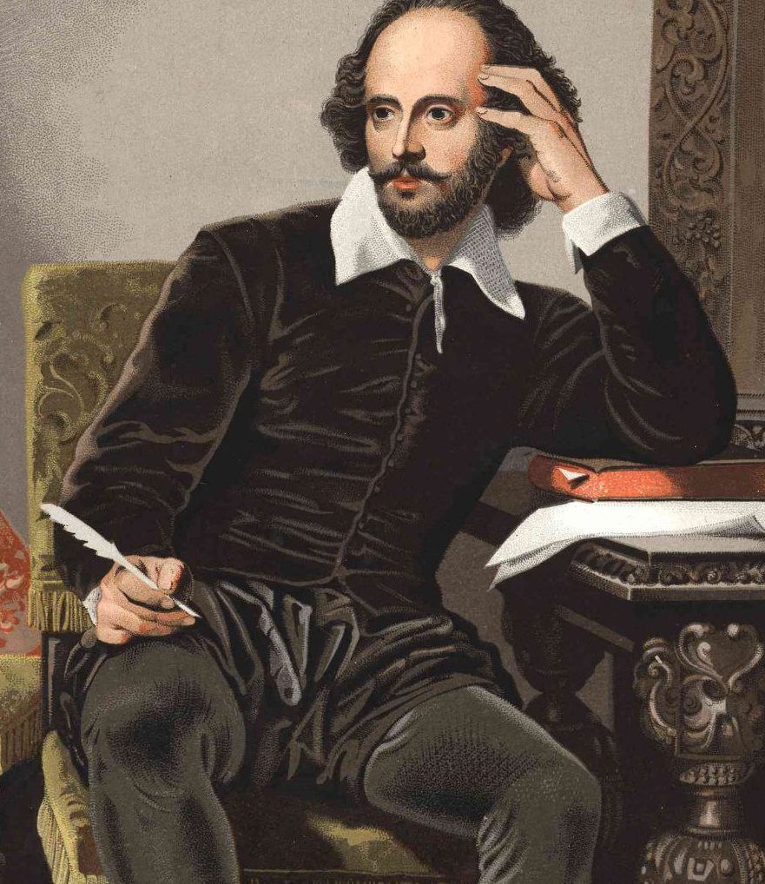
William Shakespeare
Shakespeare uses about 20000 words throughout his 37 plays . That’s not a huge number today but when he was writing, it was.
And it’s possibly not what the words are but it’s how creatively he uses those words that is his genius.

Slide 8
Quotes by William Shakespeare
“All’s well that ends well.”
“To be, or not to be: that is the question”
“Strong reasons make strong actions.”
“Nothing will come of nothing’’
“We have seen better days.”

Slide 9
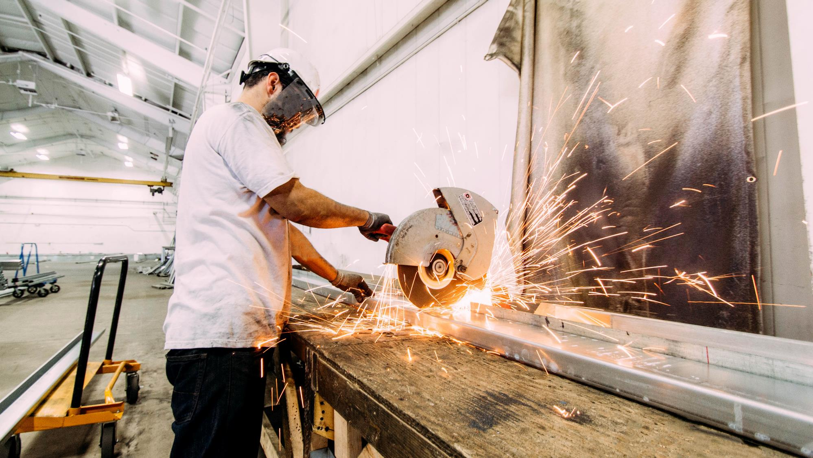

Thank You for Your Attention!

